Slide 1
Intro to use cases

Slide 2
Use cases
Use cases are used to show high level user requirements or functionalities of a system.
Use case diagram shows the relationship between the system and the outside world
Offer communication in customers, end-users and developers
Represents user scenarios that describe the thread of usage of a system
Notes:
Graphical show the scope: context diagram.

Slide 3
Main Components
Actors
  Users of the system, e.g. Student
  Surroundings of the system, e.g. Billing System
  Anything that is external to the system and interacts with it
Use cases
  Major functions (top level)
Relationships
  Between actors and use cases
Notes:
Asher Rashid
SWI Lecture 06

Slide 4
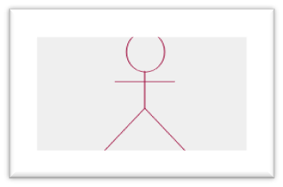
Actors
Actors can be any of the following,
  User of the system
  Other system or component of system
  Sensors
Actors interact with the system
  Give Input to the system
  Receive output from the system
  Both
UML notation of actor
(A matchstick man)
Notes:
Asher Rashid
SWI Lecture 06

Slide 5
Actor description
UML diagram is not just a diagram
  Each actor needs an associated documentation
  Brief Explanation of all the actors
  Mention the role of actors
For example
  Student
    A person who is registered to take classes
  Lecturer
    A person who is certified to teach classes
  Registrar
    A person who is responsible for the maintenance of the system
Notes:
Asher Rashid
SWI Lecture 06

Slide 6
Use cases
High level functionality or service provided by the system to users
UML notation of use case, (balloon shape)
Notes:
Asher Rashid
SWI Lecture 06

Slide 7
Use case description
Use case also needs documentation
  Discuss high level functionality representing through use cases
  Provide input, output and detail actions of particular use cases
For example:
  Register for courses:
  This use case is started by student. It provides the capability to create, modify, and/or review a student schedule for a semester
Notes:
Asher Rashid
SWI Lecture 06

Slide 8
Use case relationship
Relationship can be of
An actor with use case
  Use case with another use case
An arrow will be drawn towards use case
UML notation of a use case relationship
(an arrow)
Notes:
Asher Rashid
SWI Lecture 06

Slide 9
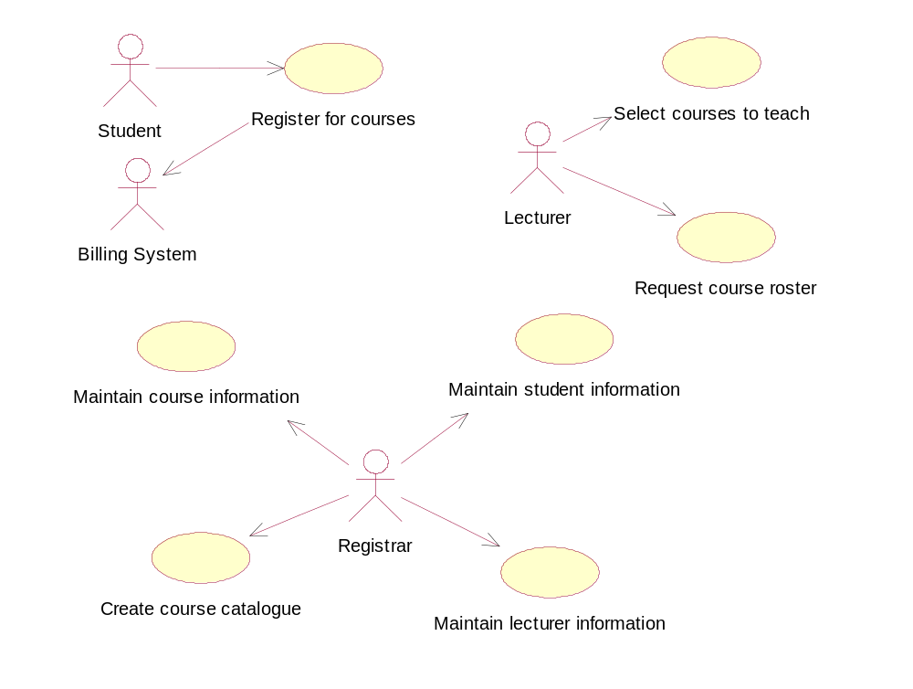
Use case Diagram
Notes:
Asher Rashid
SWI Lecture 06

Slide 10
Scenarios
Formally, use cases are derived from scenarios
Full understanding of scenarios in sequence is needed.
For example:
  Scenario 1: Account opened, i.e. Success
    Steps and outcomes to open account
  Scenario 2: Account not opened because credit check fails

Slide 11
scenario may include
  primary actors
  preconditions of scenario
  Main tasks or functions are performed by the actor
  Possible extensions

Slide 12
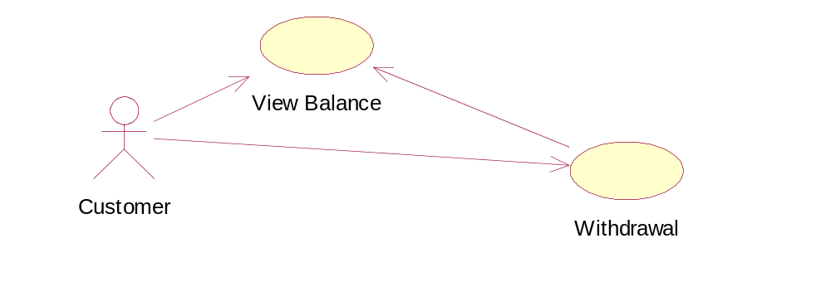
Includes
For the completion of one functionality (use case), we need another functionality (use case)
E.g. Bank customer can view balance directly or after withdrawal he can view his/her balance.
<<INCLUDES>>

Slide 13
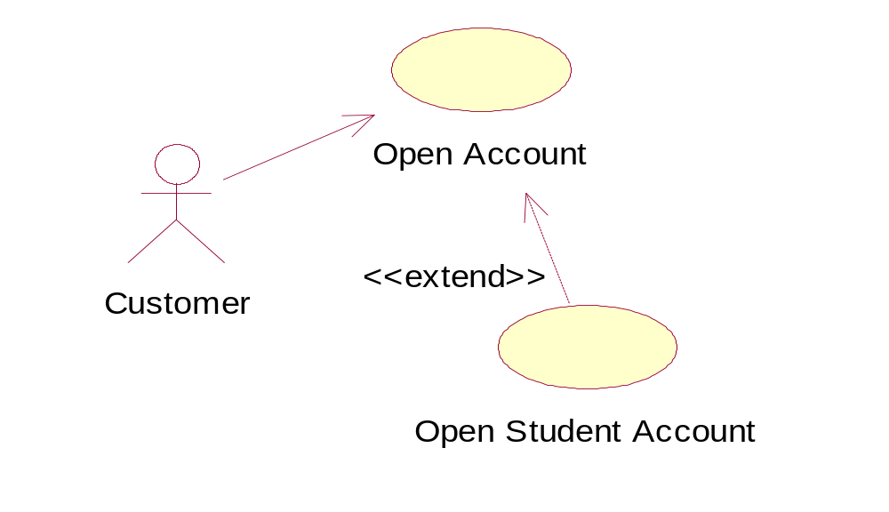
Extend
We can extend the behaviour of one task via an extend relationship
Used to make optional interactions explicit or to handle exceptional cases
e.g. Customer may open an account or open student account

Slide 14
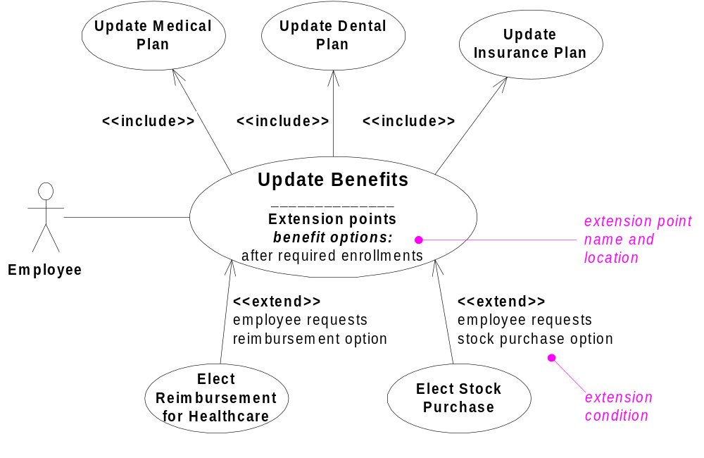
Example: HR System

Slide 15
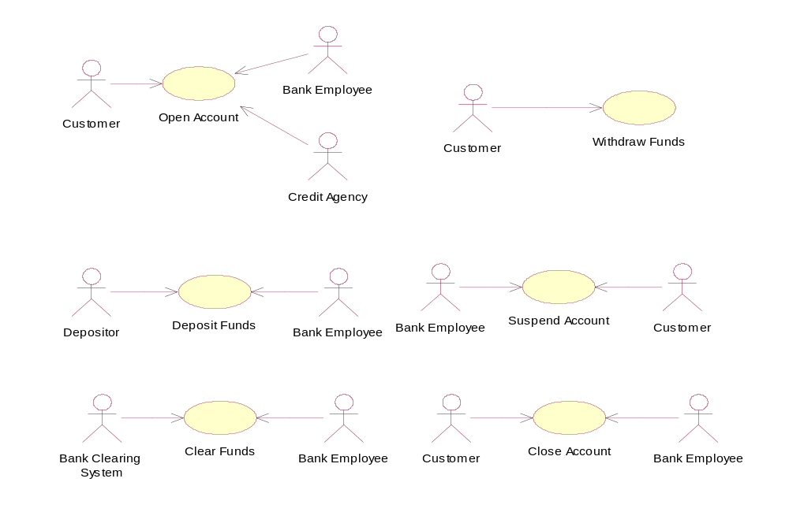
Bank system example

Slide 16
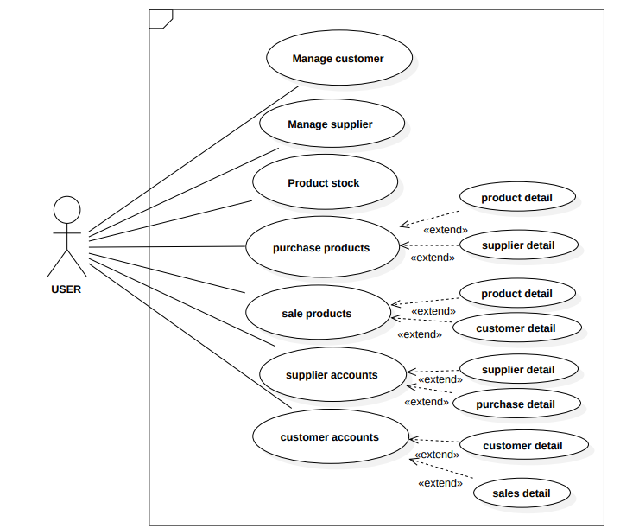
Use case for point of sale

Slide 17
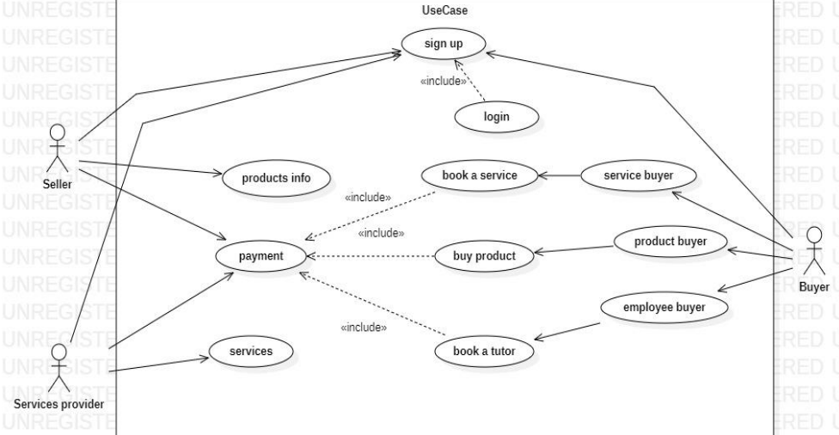
Use case for services and product byers

Slide 18
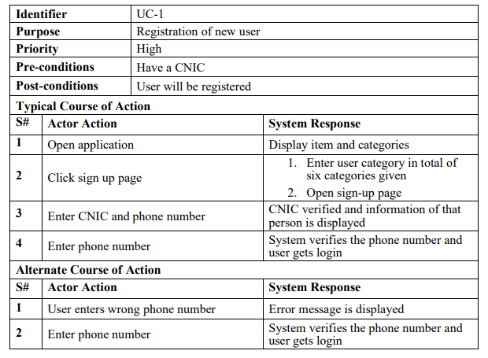
USE CASE 1

Slide 19
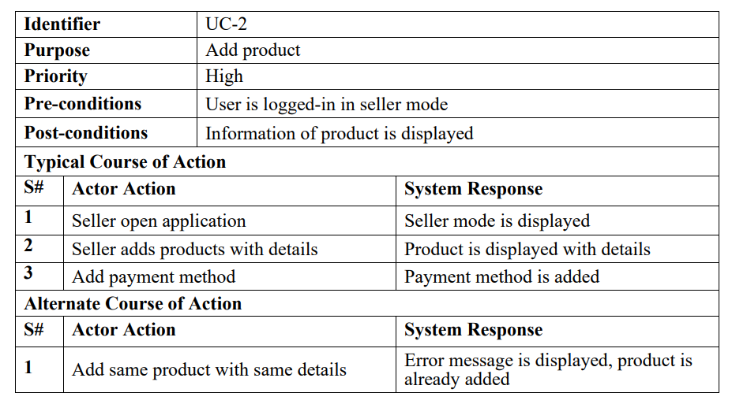
USE CASE 2

Slide 20
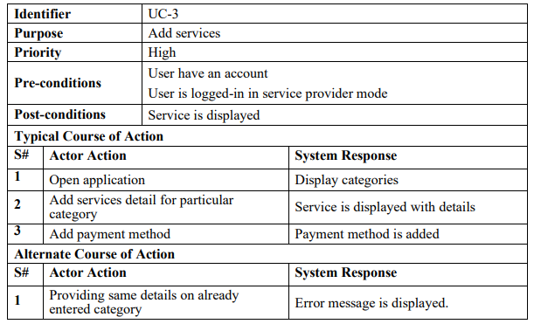
USE CASE 3

Slide 21
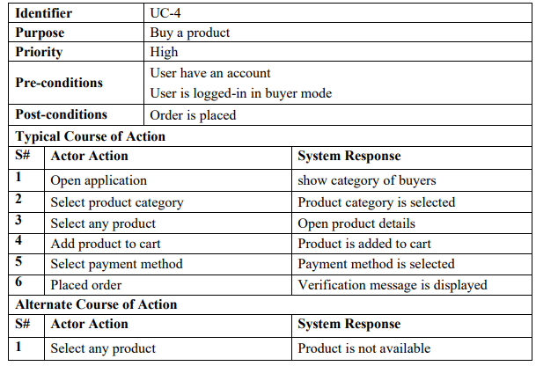
USE CASE 4

Slide 22
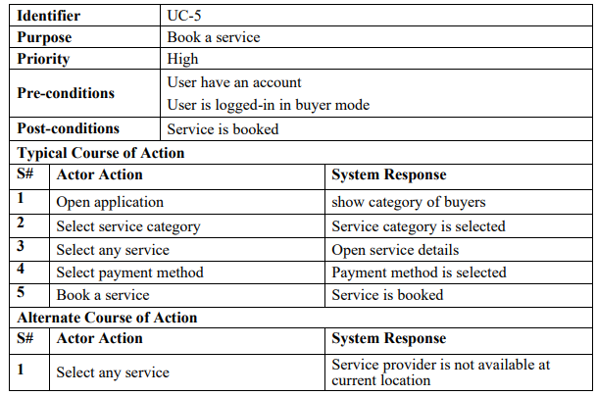
USE CASE 5

Slide 23
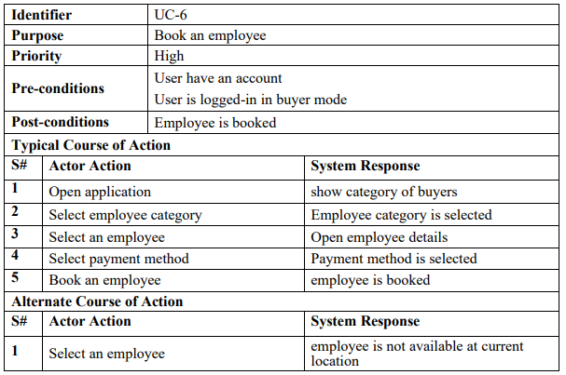
USE CASE 6

